Slide 1

SERVICE BOOKING MANAGEMENT SYSTEM
TEAM:
SHRUNGA RAVI
NIHAL RAFIQ
CHIRAG GOWDA

Slide 2

Outline
Problem Statement
Objective
Microservices
Project Overview
Onboarding-Architecture
Project Flow
Technology and Tools Used
Conclusion

Slide 3
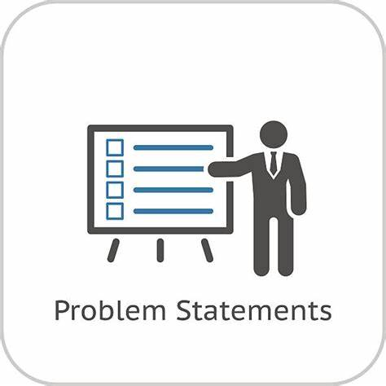
Problem Statement
A leading manufacturing companies support department wants to optimize their Service Booking process for a variety of the products. They want a unified platform for maintaining their service booking related activities in a centralized manner.

Slide 4
Objectives
These Microservices performs following operations
user management :Register,Updating and Listing users details.
Product Management: Adding ,Updating ,Listing and Deleting Product.
Service Booking Management: Creating Service Booking or Service Request ,Status of booking needs to be changed and Status would be pending, assigned, resolved.

Slide 5
MICROSERVICES
User Management
Product Management
Service Management
Authentication

Slide 6
Project Overview

Slide 7
Project Overview
Create
User
Update
user
Product
service
List
Report

Slide 8
Onboarding Architecture

Slide 9
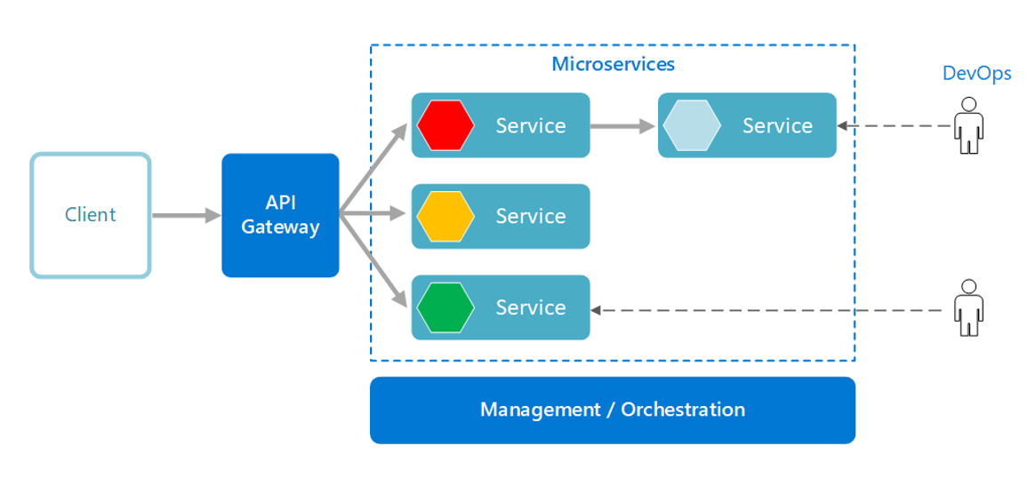
Architecture:

Slide 10
Project Flow

Slide 11
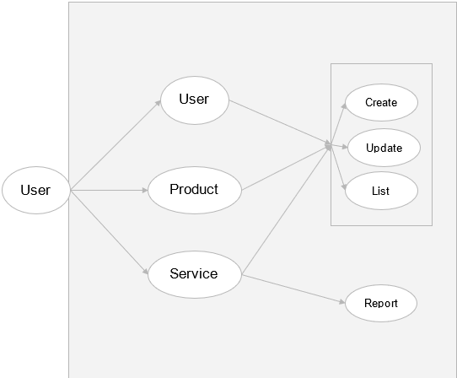
Project Flow

Slide 12




Challenges Faced
Integration
Working Virtually
Learning new Technologies
Debugging errors

Slide 13

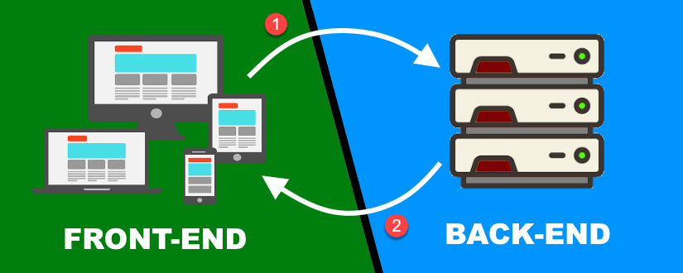
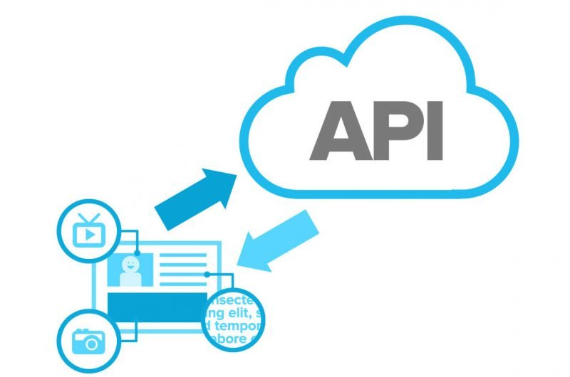
CHALLENGES
Working remotely is one of the challenge we faces
Integrating From frontend and backend code
Fetching data from the external api
Resolving errors in coding

Slide 14






Technologies and Tools Used

Slide 15
Screen Shots

Slide 16
Conclusion

Slide 17
Thank You

